Slide 1


Executive Summary Airline Incident before Earnings Report
Thip Rattanavilay
DSC640

Slide 2
Table of Content
Fatalities Report for All Airlines (1985 vs 2014)
Fatal Accidents Report for All Airlines (1985 vs 2014)
Incidents Report for All Airlines (1985 vs 2014)
Accidents vs Fatalities (2000-2019)
Traffic Fatalities vs Airline Fatalities
Airline Net Profit by Year

Slide 3

Accidents Happen and it out of the Airlines control
Pilots are involved at every stage of the flight, and pilot errors can occur at any one of them
Airline Accidents could happen for many reasons. Implementing safety measures can reduce casualties and fatalities.
Some accidents are caused by bad weather, human errors or objects in the sky
Mechanical Failure. Equipment failures account for about 20 percent of aviation crashes

Slide 4
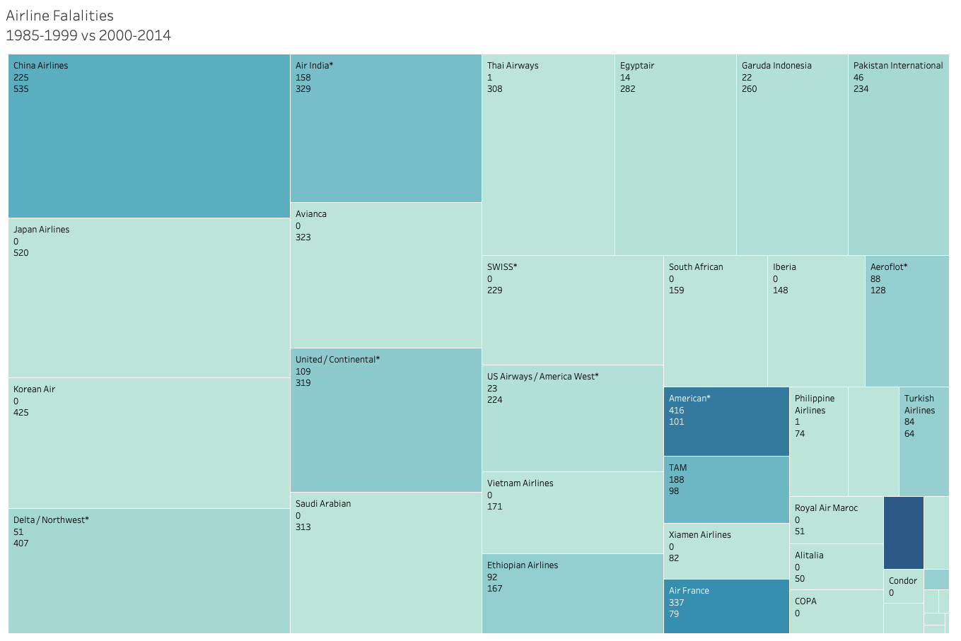
Fatalities Report for All Airlines (1985 vs 2014)
China Airlines seem to have more fatalities during 1985 than 2014.
Next highest fatalities is Japan at 520 death
One with the leased death is Nippon Airlines with on 1 death
This graph show the fatalities rate decline as it moves towards 20014

Slide 5
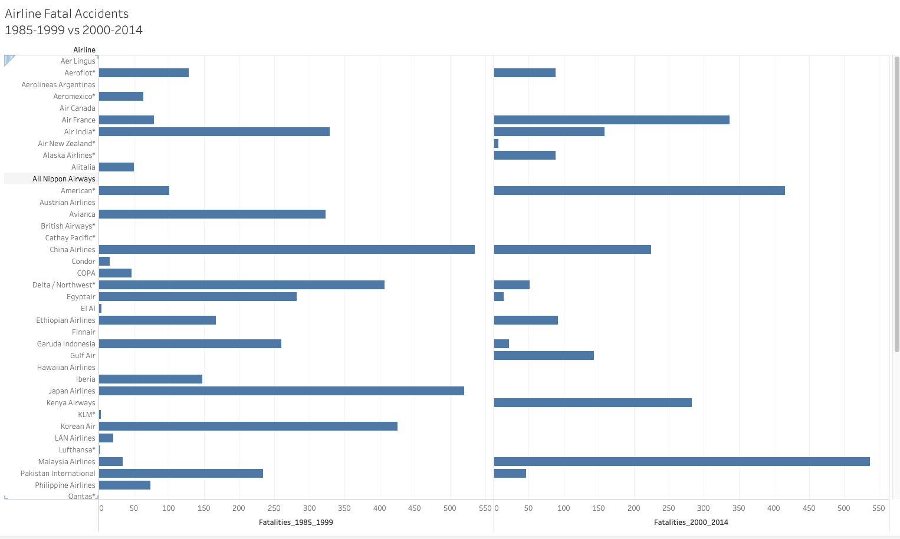
Fatal Accidents Report for All Airlines (1985 vs 2014)
For fatal Accidents we see Airline occupancy has a steady level where the Accidents have reduced from 1985 to 2014.
China Air reduced by nearly half.
Malaysia Airlines has increased their Fatal rate by 90% from 1985 to 2014.

Slide 6
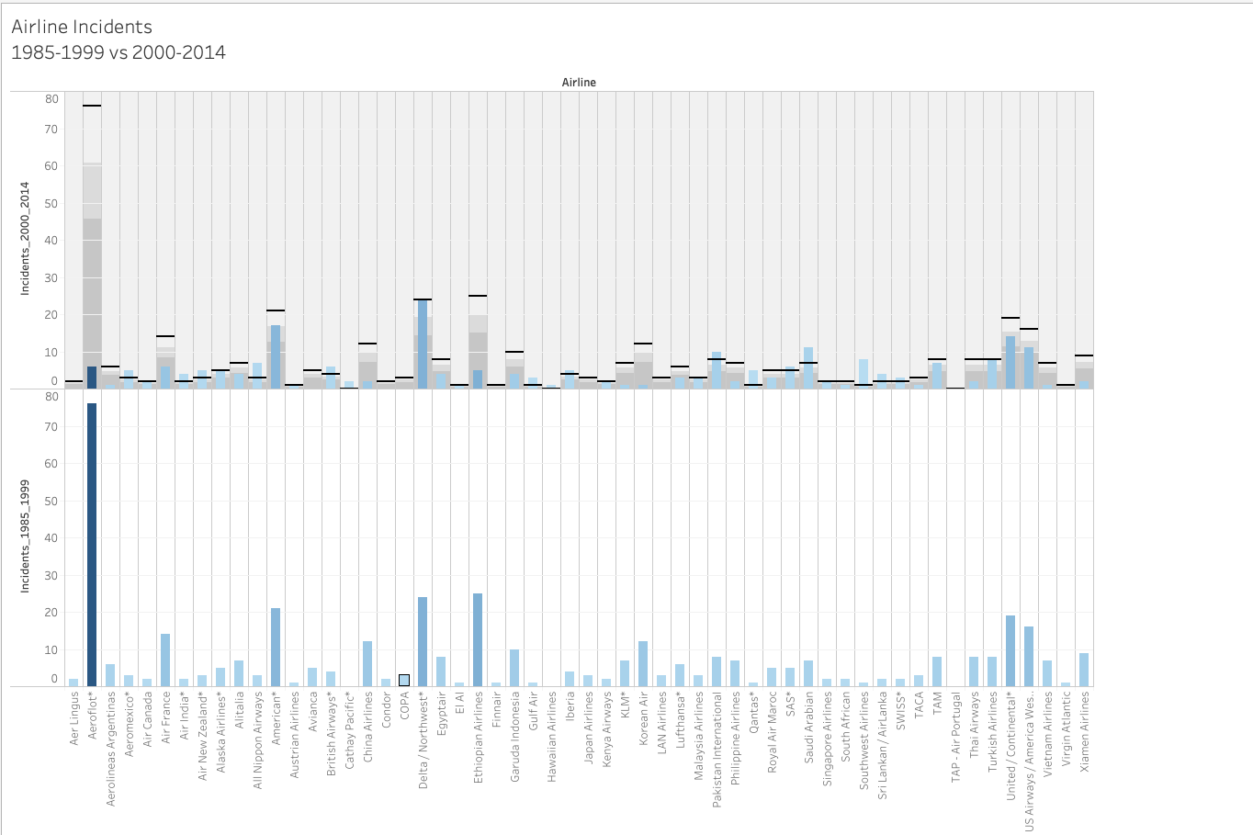
Incidents Report for All Airlines (1985 vs 2014)
List of the Airlines with the highest reported Incidents in the last between 1985 to 2014

Slide 7
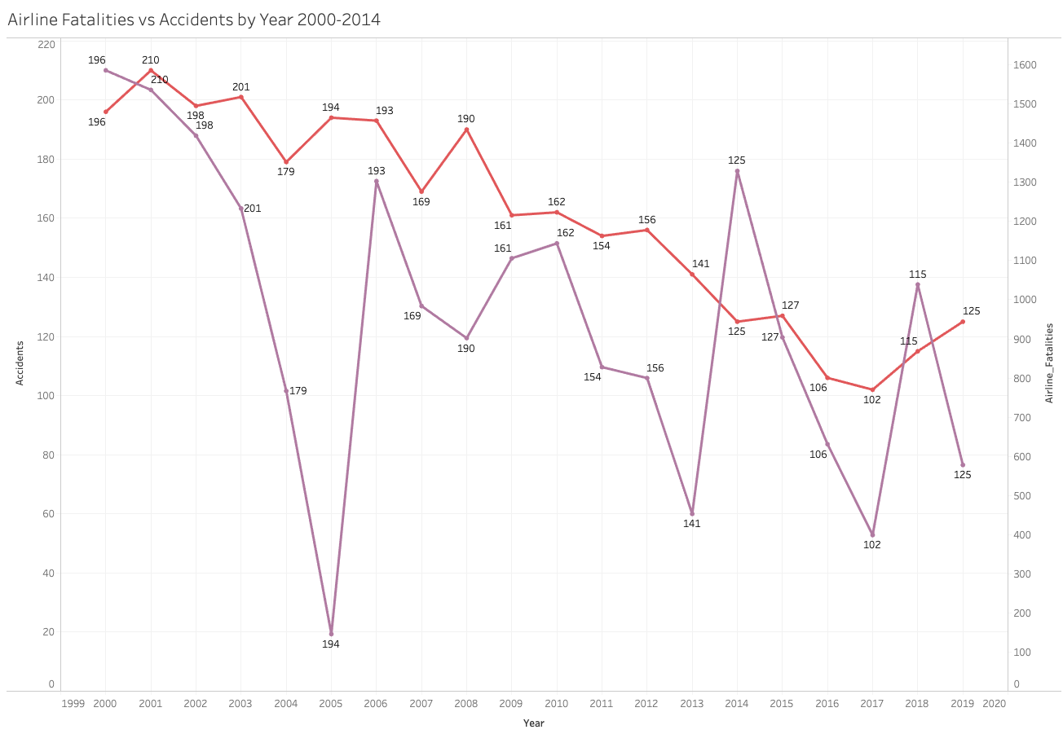
Accidents vs Fatalities (2000-2019)
During 2005 Fatalities rate fell a record 164 compared to 1,586 in 2000. Both Accidents and Fatalities are seeing huge improvement per year.

Slide 8
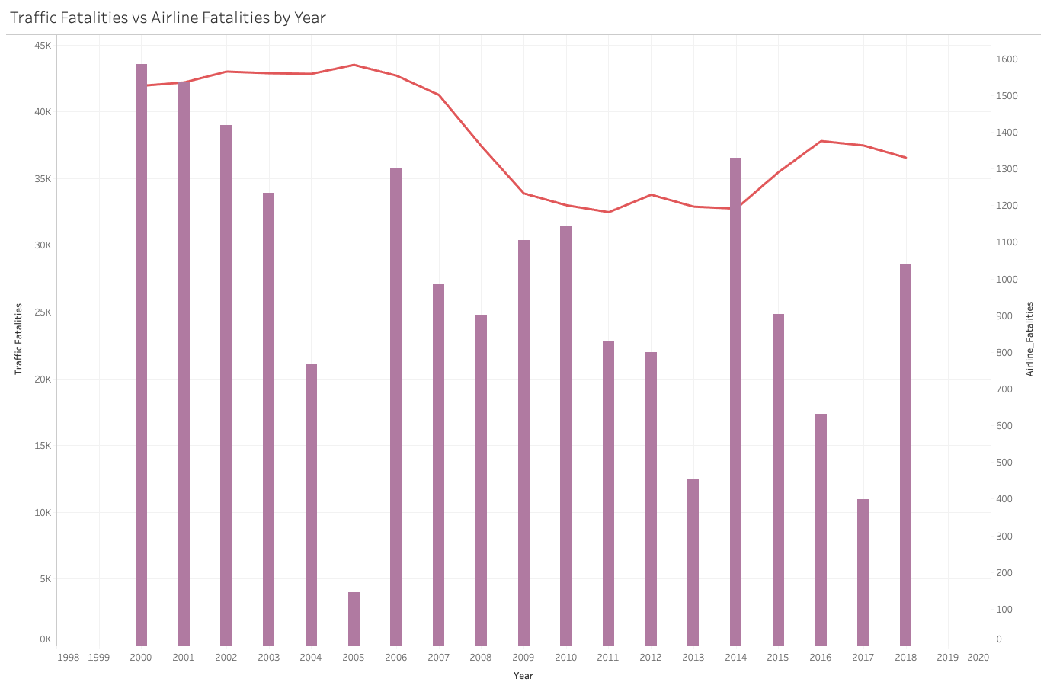
Traffic Fatalities vs Airline Fatalities
Comparing Airline Fatalities vs Traffic accidents, the Airline still has a very less count.

Slide 9
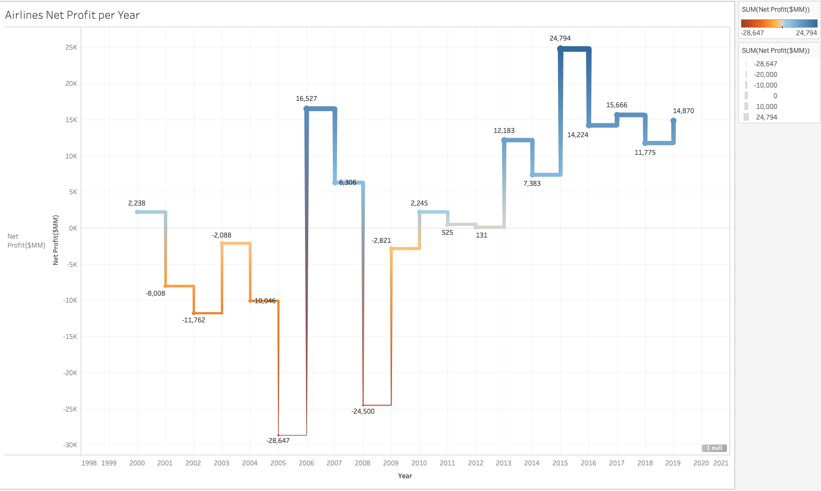
Airline Profit Earnings by during these accidents
This report show that airlines are has steadily increased their profits in the recent years. It shows that Airline has decreased their Fatalities, Fatal and Incident rate which gives the people the confidence to fly again.
The future growth among this airlines seem profitable if they ensure safe traveling standards are met at the highest level.

Slide 10
Conclusion
As I concluded, the graph and stats shows how the the number of incidents and fatalities has decreased in the recent times compared to last century, shows us the increase of safety measures implemented over the period. When compared to the Traffic accidents with air travel the percentage is very less. The increase of the net profit of the airline industry over the period, shows the people that traveling is safe.
I would recommend not to fly with Malyaia airline for that they increased their fatalities rate by nearly 90%. America Airline is second to this list and they have increased there fatalities 87%

Slide 11
References
Reference:
https://aviation-safety.net/database/
Airline Accidents: List of accidents and incidents involving commercial aircraft - Wikipedia
Airline Safety: https://github.com/fivethirtyeight/data/tree/master/airline-safety
Bellevue dataset - https://github.com/fivethirtyeight/data/tree/master/airline-safety
https://docs.google.com/spreadsheets/d/1SDp7p1y6m7N5xD5_fpOkYOrJvd68V7iy6etXy2cetb8/edit#gid=1448957446
https://www.nhtsa.gov/research-data/fatality-analysis-reporting-system-fars

